Slide 1
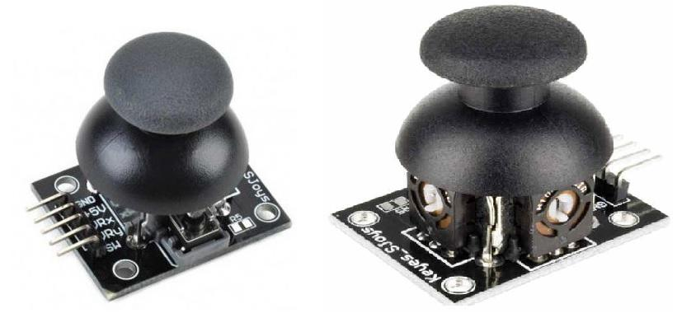
Week 4: Joystick Configuration
Week 4: Link to slides here https://tinyurl.com/crmt42eb

Slide 2
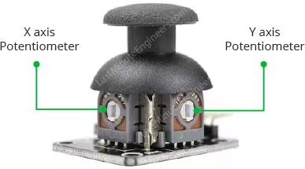
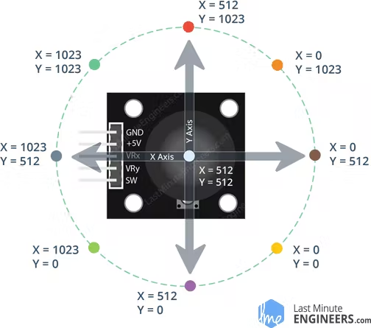
Joystick module
The joystick module is used to communicate motion in 2D to an arduino. This is done through two independent 5K potentiometers (one per axis)
The X axis and Y axis plane on the Joystick is highlighted below in the following image

Slide 3
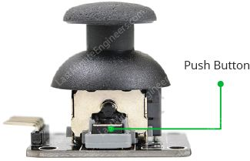
Joystick module
The module also has a push button that activates when you press down on the joystick. You’ll hear a little click, signifying that the button has been pressed.

Slide 4
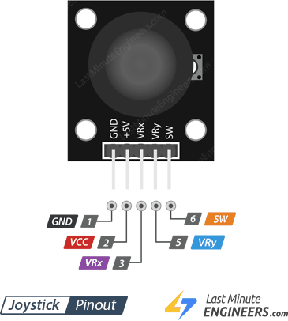
Joystick Pin Layout
The Joystick module has the following pins
GND: This is the ground pin
VCC: This provides power to the module and is usually connected to your power supply
Either 5v on the arduino or 3.3v
VRX: This is the horizontal(x axis) output. This controls the output on the left and right plane.
VRY: This controls the vertical(y axis) output which does the same thing as VRX but for the up and down plane.
SW: is the output from the pushbutton switch. Just tells you if the button has been pressed or not

Slide 5
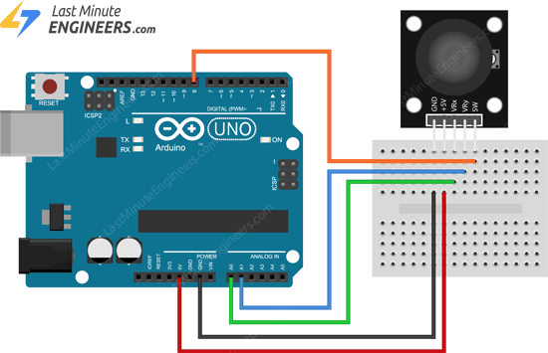
Example: Control Motors w/ BT module
Module to Arduino
VRx VRy SW 5V GND | A0 A1 8 5V GND
CLICK TO SEE LINK TO IMAGE
CLICK ON IMAGE TO VIEW FULLSCREEN

Slide 6
Setting up the program for this example
https://tinyurl.com/2jntn85e
Above is the link to the program.
Once the program is done uploading open up the serial monitor and start moving the joystick
You should see the monitor outputting the position of the joystick
Reference the following image to see the Joystick position

Slide 7
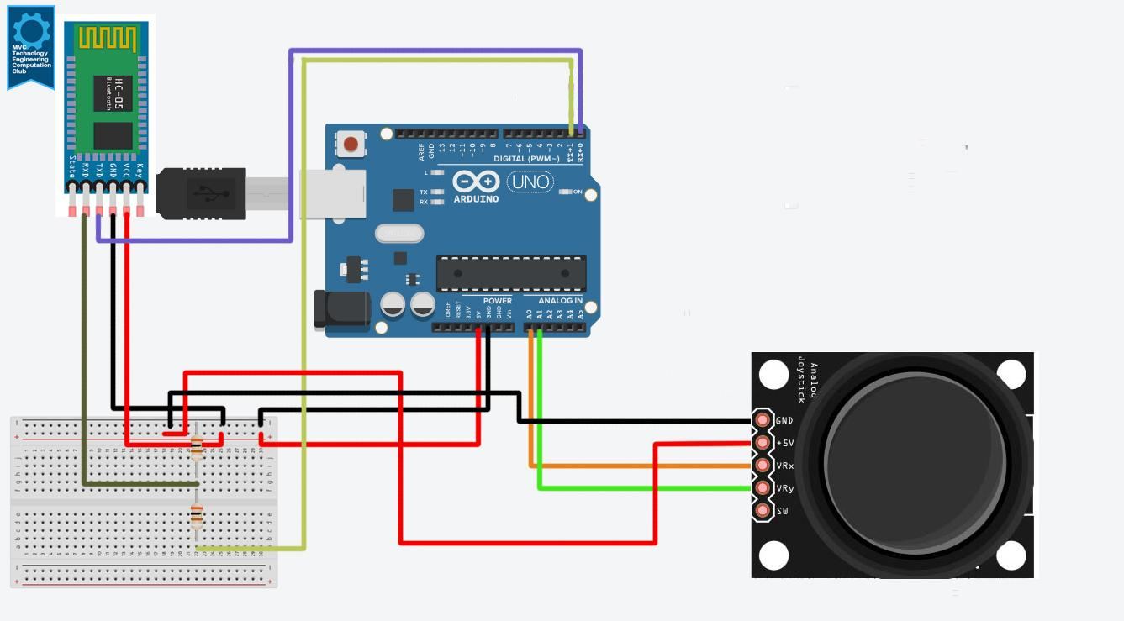
Connecting Bluetooth and Joystick
Next we’re going to connect the Bluetooth module to our Joystick so it can act as a controller for the RC Car
Please refer to the following sketch
JoyStick to Arduino
VRx VRy 5V GND | A0 A1 5V GND
Bluetooth to Arduino
RX TX VCC GND | TX RX 5V GND
CLICK ON IMAGE TO VIEW FULLSCREEN

Slide 8
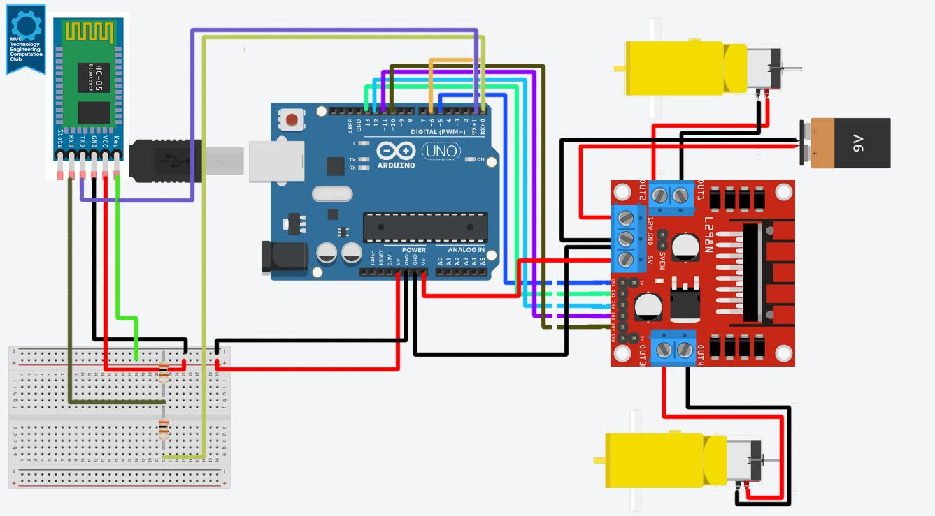
Master/Slave Configuration: Slave device
Next we’re going to need to configure our bluetooth module for our previous sketch(Week 3 Bluetooth Motor Driver) as the Slave device and our Joystick Bluetooth as the Master device.
Referencing our previous sketch, connect the EN pin to the positive node on the bread board and swap the position of the RX and TX to be RX -> RX and TX -> TX
Bluetooth to Arduino
CLICK ON IMAGE TO VIEW FULLSCREEN
RX TX VCC GND EN | TX RX 5V GND 5V

Slide 9
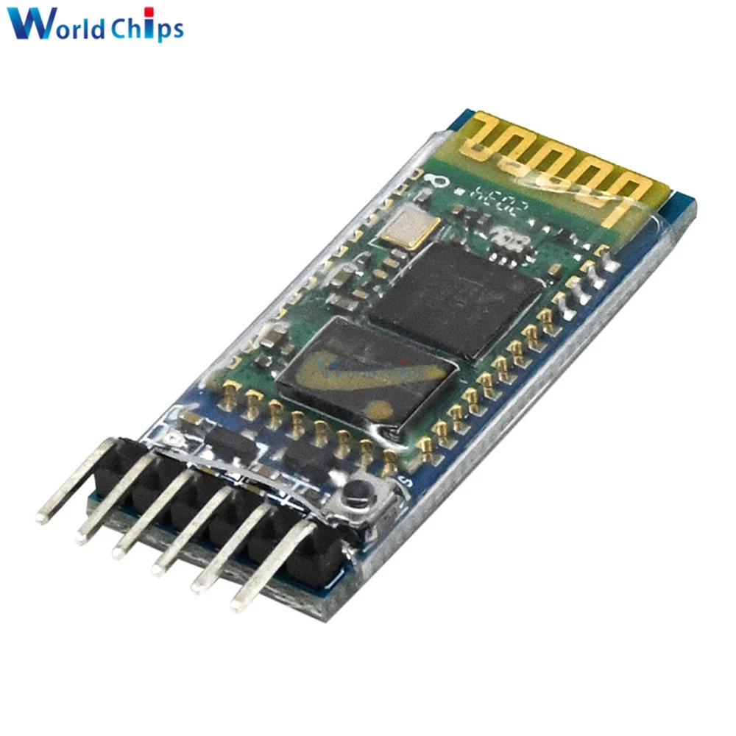
Master/Slave Configuration: Slave device
From here we’re going to upload an empty sketch to the arduino (Remember to remove the TX and RX pins before uploading).
Once the empty sketch has been uploaded, open up the serial monitor and set the Baud Rate to 9600 which is the default rate and set communication method to Carriage Return and New Line Ending(Both NL & CR)
Then on Bluetooth module click on little white button as referenced in the following image
Once the module blinks once every 2 seconds Module has entered Command Mode and now we can move onto the IDE
← button

Slide 10
Master/Slave Configuration: Slave Device
Back onto the serial monitor we’re going to be typing in some AT commands
Refer to step 2 in the previous slide to get the serial monitor setup
Next we’re going to be typing in some commands (For a semi list refer to the following link(https://bytesnbits.co.uk/at-commands-for-bluetooth-modules/))
A typical test command to see if the Bluetooth is in command mode is the following AT and you should get OK as a response
Before most commands you’re going to want to put AT. To check the bluetooth’s baud rate type AT+UART?
To check its role(either master or slave) type AT+ROLE? By default its 0 as all HC-05 modules are in slave mode by default
Once all the testing is done we’re going to need the bluetooth’s address to configure the master device so type AT+ADDR? to get the address of the module
Once you have the information please write it down or copy it into a google doc or notepad

Slide 11
Master/Slave Configuration: Master Device
Now with the address in hand, we’re going to configure and set up the Joystick Bluetooth sketch to be in command module
Please refer to the Joystick bluetooth sketch in the slides and connect the Key/EN pin to 5v on the breadboard and connect TX -> TX on the arduino and the same for RX -> RX (Example in the Slave device configuration)
You can then follow the same steps to setting up the bluetooth module and pressing the button on the bluetooth device as stated in the Slave device configruation
Once the serial monitor is up and you have the same baud rate and Both NL & CR set then we can type in the following AT commands
AT to see if the device is working
AT+ROLE = 1 to set the device in master mode
AT+CMODE = 0 to set the device in fix address mode (meaning it will only connect to one device)
AT+BIND = Address that you wrote down previously (This will make the master only connect to the slave device)
Once all that is done we will move onto uploading the programs for both devices

Slide 12
SOURCES for these slides
How To Configure and Pair Two HC-05 Bluetooth Modules as Master and Slave | AT Commands - How To Mechatronics
In-Depth: How 2-Axis Joystick Works? Interface with Arduino & Processing
Configuring 8 way digital joysticks and analog joysticks with Arduino and ESP32
Arduino Tutorial 32: Understanding and Using Joysticks in a Project
Arduino Thumb Joystick to Processing
Using AT Commands to Set Up Your Bluetooth Module : HC-05 and HC-06 (loud intro)
AT COMMAND REFERENCE

